Slide 1
WEYLAND ENERGY
How a PPA works
Lunch & Learn · Priya Nair & Marcus Bell · 4 June 2026

Slide 2
“A long-term promise: we deliver green power, you pay a fixed price.”
— Priya Nair
WEYLAND ENERGY · How a PPA works
2

Slide 3
Why both sides want it
Generator (us) | Buyer (e.g. Arcturus Steel)
Predictable revenue – banks lend against it | Predictable energy cost for 10–15 years
Lower cost of capital | Proof of green power (guarantees of origin)
Less exposure to market price swings | Decarbonises products – green steel
WEYLAND ENERGY · How a PPA works
3

Slide 4
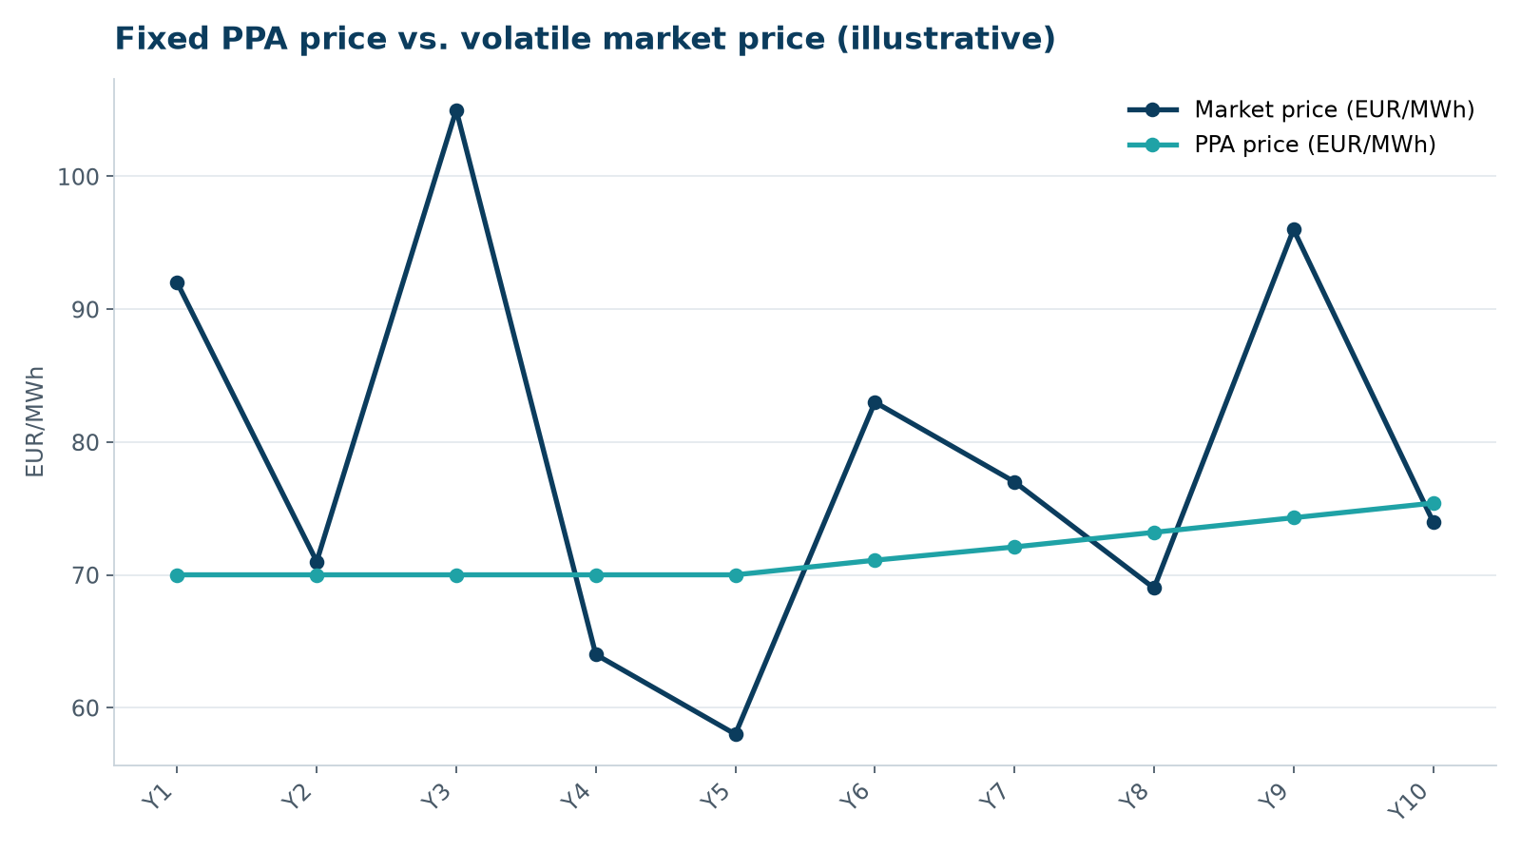
Fixed price vs. market price
WEYLAND ENERGY · How a PPA works
4
Notes:
Illustrative numbers only – the real Arcturus price is confidential.

Slide 5
Physical, virtual, pay-as-produced, baseload
• Physical PPA: power is actually delivered to the buyer's balancing group
• Virtual PPA: financial swap around the market price, no physical delivery
• Pay-as-produced: buyer takes a share of what the wind farm produces
• Baseload: a flat profile – the seller must buy the gaps on the market
WEYLAND ENERGY · How a PPA works
5

Slide 6
Our example: WE-PPA-2026-004
150
15
590
31 %
MW from Harrow Bay
years from COD 2028
GWh per year (approx.)
pay-as-produced share (31.25 %)
• Signed with Arcturus Steel AG on 12 May 2026 in London
WEYLAND ENERGY · How a PPA works
6

Slide 7
What can go wrong?
• Delay to COD – long-stop date and capped delay damages
• Buyer credit – parent company guarantee
• Negative prices – no payment after 4 hours
• Change in law – renegotiation clause
WEYLAND ENERGY · How a PPA works
7

Slide 8
Who does what at Weyland
• Origination & negotiation: Executive Board, Legal & Contracts
• Price models: Finance & Controlling
• Delivery & metering: Asset Operations
• Reporting to the buyer: Harrow Bay project team (until COD)
WEYLAND ENERGY · How a PPA works
8

Slide 9
WEYLAND ENERGY
Thank you
Next Lunch & Learn: Battery storage basics

